Slide 1
SoftHier Bi-Weekly Meeting
Chi Zhang chizhang@iis.ee.ethz.ch
Thomas Benz tbenz@iis.ee.ethz.ch
Luca Colagrande colluca@iis.ee.ethz.ch

Slide 2
SoftHier Progress General Updates
DeepSeek-V3 on SoftHier: Decoding Analysis with FP8
Chip2Chip Interconnect Analyze under high Expert-Parallelism

Slide 3
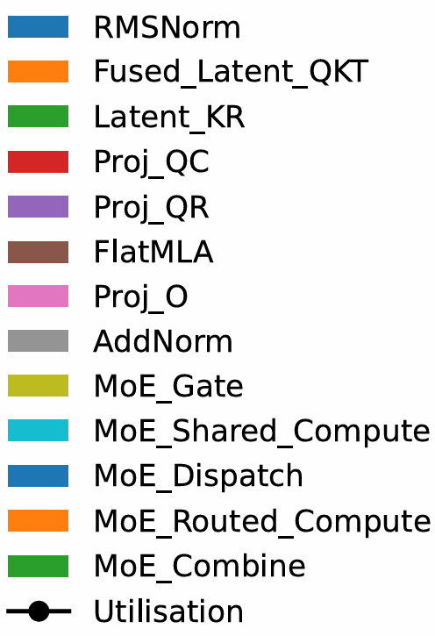
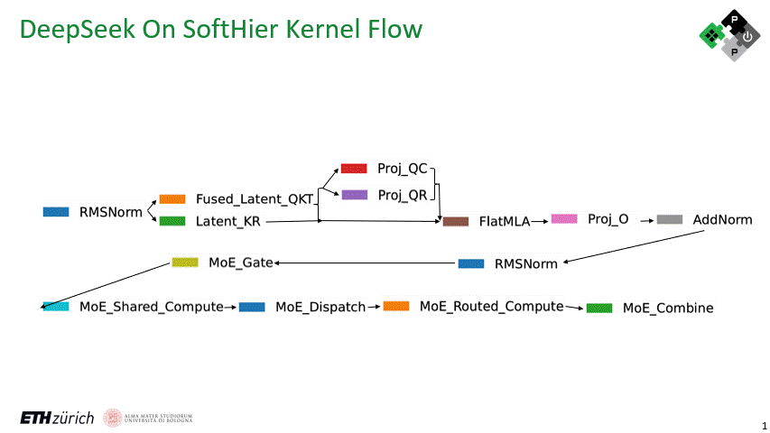
Weight Absorption
DeepSeekV3 Dataflow on SoftHier
MLA
Weight absorption tricks + FlatMLA
MoE
First compute shared expert
Dispatch tokens for routed experts
Compute per routed expert
Combine weighted outputs

Slide 4
Expert Parallelism (EP) Approach
Concept
Each chip handles a subset of experts in parallel
Requires heavy inter-chip communication (dispatch & combine)
MLA + Shared Expert + Gate
Dispatch
Routed Expert
Combine
Expert 0
SoftHier
Chip 0
k
SoftHier
Chip 0
SoftHier
Chip 0
SoftHier
Chip 0
Expert 1
batch
k
Expert 2
k
Expert 3
k
Expert 4
SoftHier
Chip 1
k
SoftHier
Chip 1
SoftHier
Chip 1
SoftHier
Chip 1
Expert 5
batch
k
Expert 6
k
Expert 7
k
C2C Interconnect
Expert 8
SoftHier
Chip 2
k
SoftHier
Chip 2
SoftHier
Chip 2
SoftHier
Chip 2
Expert 9
batch
k
Expert 10
k
Expert 11
k
……
……
……
……
Expert 252
SoftHier
Chip 63
k
SoftHier
Chip 63
SoftHier
Chip 63
SoftHier
Chip 63
Expert 253
batch
k
Expert 254
k
Expert 255
k
Time

Slide 5
DeepSeekv3 FP8 Decoding on SoftHier
Expert 0
SoftHier
Chip 0
Expert 1
SoftHier Chip Configuration
Each cluster with one 32x32 CE array RedMule (2TFLOPs/cluster)
32x32 cluster with total 2048 TFLOPs @FP8
32 HBM2.ch on both west and south die boundary (4TB/s)
Expert-Parallelism
Each chip handles a subset of experts in parallel
Requires heavy inter-chip communication (dispatch & combine)
Overlaps communication with kernel execution
Configure with EP-64
Expert 2
Expert 3
Expert 4
SoftHier
Chip 1
Expert 5
Expert 6
Expert 7
C2C Interconnect
Expert 8
SoftHier
Chip 2
Expert 9
Expert 10
Expert 11
……
Expert 252
SoftHier
Chip 63
Expert 253
Expert 254
Expert 255
Kernel Compute
MLA + Shared Expert + Gate
MLA + Shared Expert + Gate
Routed Expert
Routed Expert
MLA + Shared Expert + Gate
C2C Communication
Dispatch
Dispatch
Combine
Combine
Time

Slide 6
DeepSeekv3 FP8 Decoding Results
Decoding Setting
Speculative Decoding
Draft Length = 4
Accept Rate = 75%
Expert-Parallelism = 64
Key Metrics
Throughput: tokens/s/chip
TPOT: avg. time per token for each user (target <100 ms)
Target TPOT

Slide 7
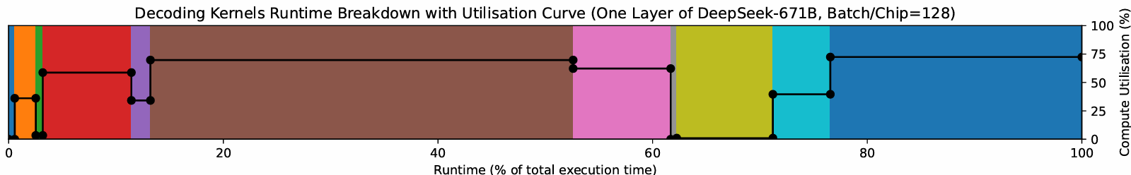
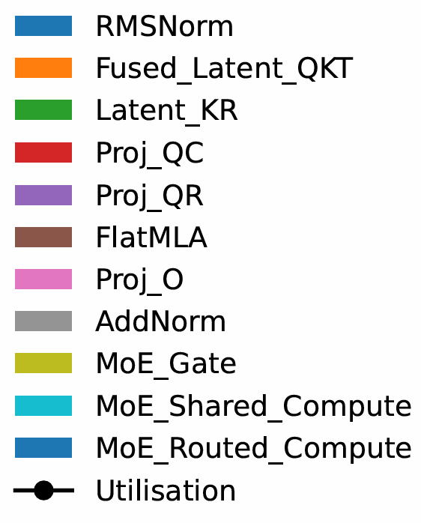
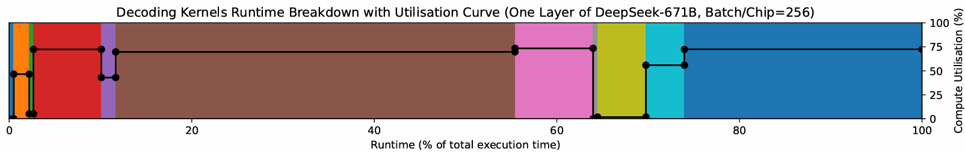
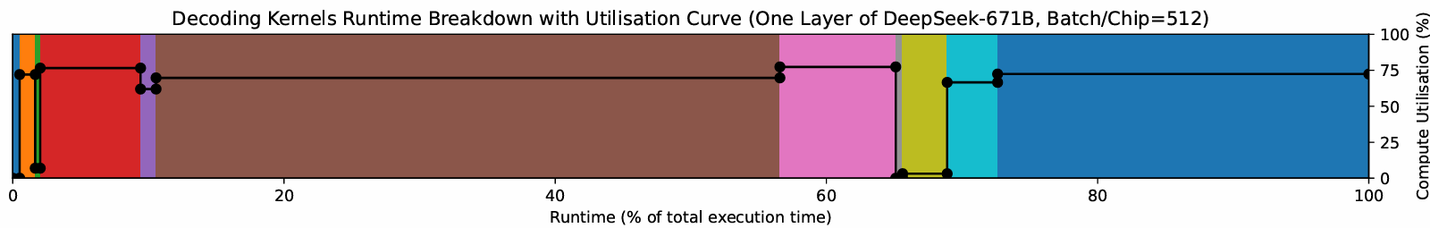
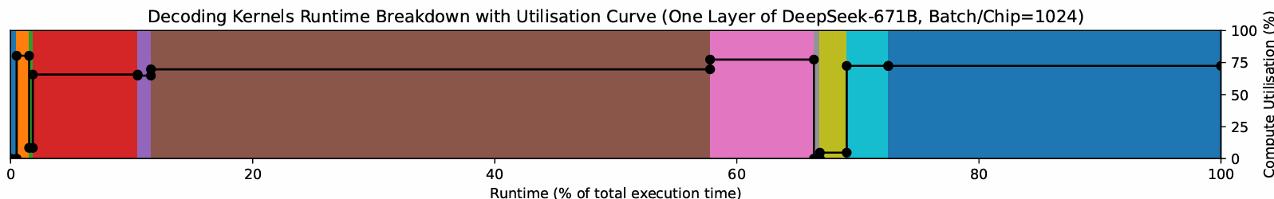
DeepSeekv3 FP8 Decoding Results – Kernel Breakdown

Slide 8
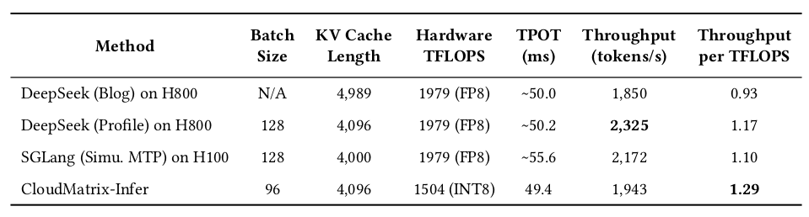
Expert Parallelism Results
Performance
Batch size=128 → TPOT=41 ms, throughput=6210 tokens/s/chip
Comparison with SoA
SoftHier Speculative Decoding
(draft_len=4, accept rate=0.75)
128
4096
1024(FP16)
73
3497
3.41
SoftHier Speculative Decoding
(draft_len=4, accept rate=0.75)
128
4096
2048(FP8)
41
6210
3.03
SoftHier Speculative Decoding
(draft_len=4, accept rate=0.75)
256
4096
2048(FP8)
74
6897
3.36

Slide 9
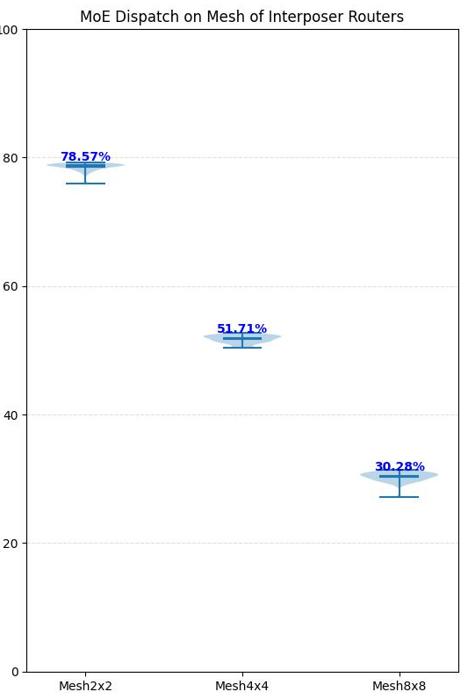
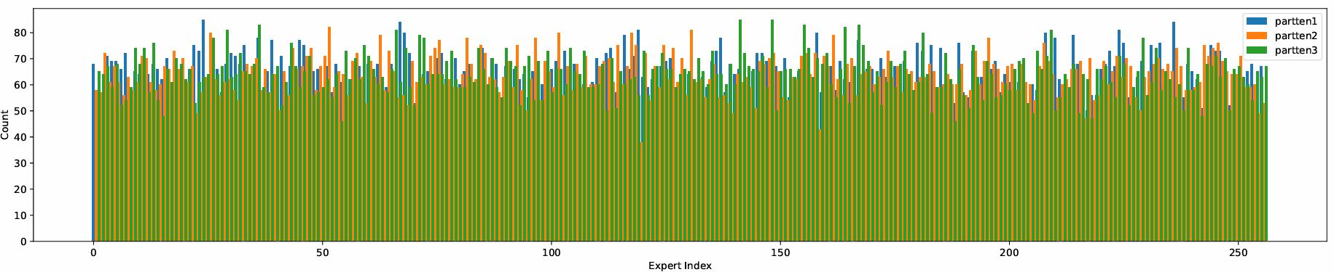
Chip2Chip Interconnect Analysing
Motivation
C2C communication need to overlap with kernel computation
Supposing we connect chips with on-chip routers on active interposer, with a 2D Mesh
Analyse the link BW required
Experiment
Use GVSoC Router model for emulation
Evaluate the MoE-Dispatch Phase
Generate Expert Activation Distribution
For EP-64 (Mesh8x8), Ideal.BW uti ~0.3
BW requirement per Link > 455 GB/s
Improvement Point
Support arbitrary end-points collective operation on Interposer routers?
SoftHier
Chip 0
SoftHier
Chip 1
SoftHier
Chip 2
R
R
R
SoftHier
Chip 3
SoftHier
Chip 4
SoftHier
Chip 5
R
R
Ideal BW Uti%
R
SoftHier
Chip 6
SoftHier
Chip 7
SoftHier
Chip 8
R
R
R
Active Interposer
Generate Expert Activation Distribution Examples

Slide 10
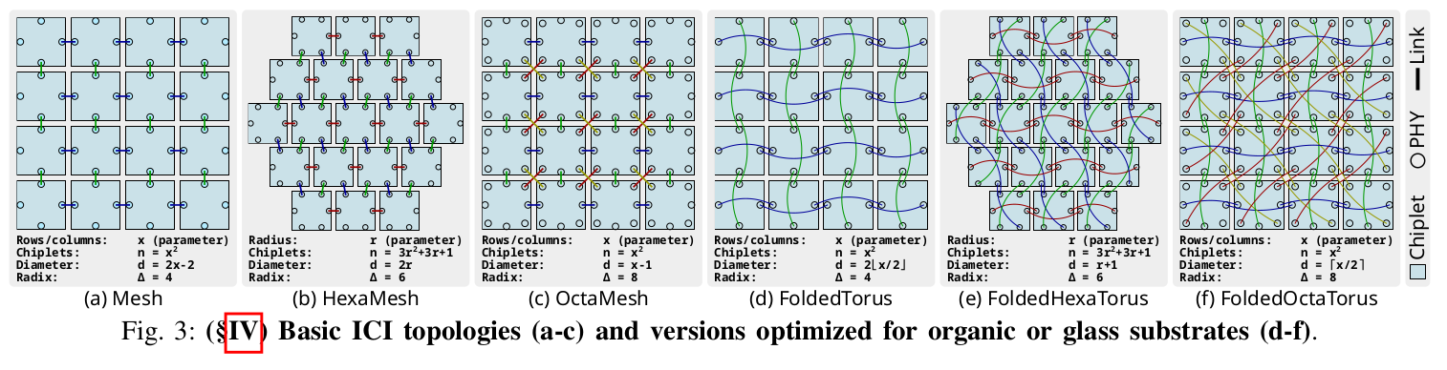
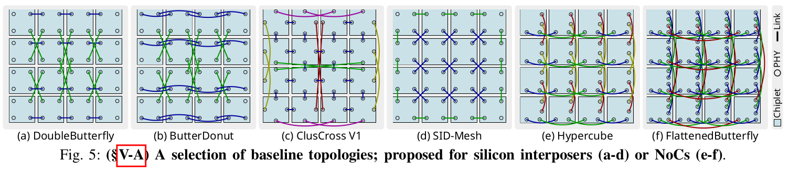
More Network-on-Wafer Topology to Evaluate
Iff, Patrick, Maciej Besta, and Torsten Hoefler. "FoldedHexaTorus: An Inter-Chiplet Interconnect Topology for Chiplet-based Systems using Organic and Glass Substrates." arXiv preprint arXiv:2504.19878 (2025).

Slide 11
Plan For Next
We are going to merge SoftHier branch to main branch of GVSoC
Including new features (collective opertion) in NoC model and iDMA model to be merged to main
And also align with main branch development
We are going to move our focus on area cost analysis for (reduction+multicast) features on the NoC, turn to RTL development

